Slide 1
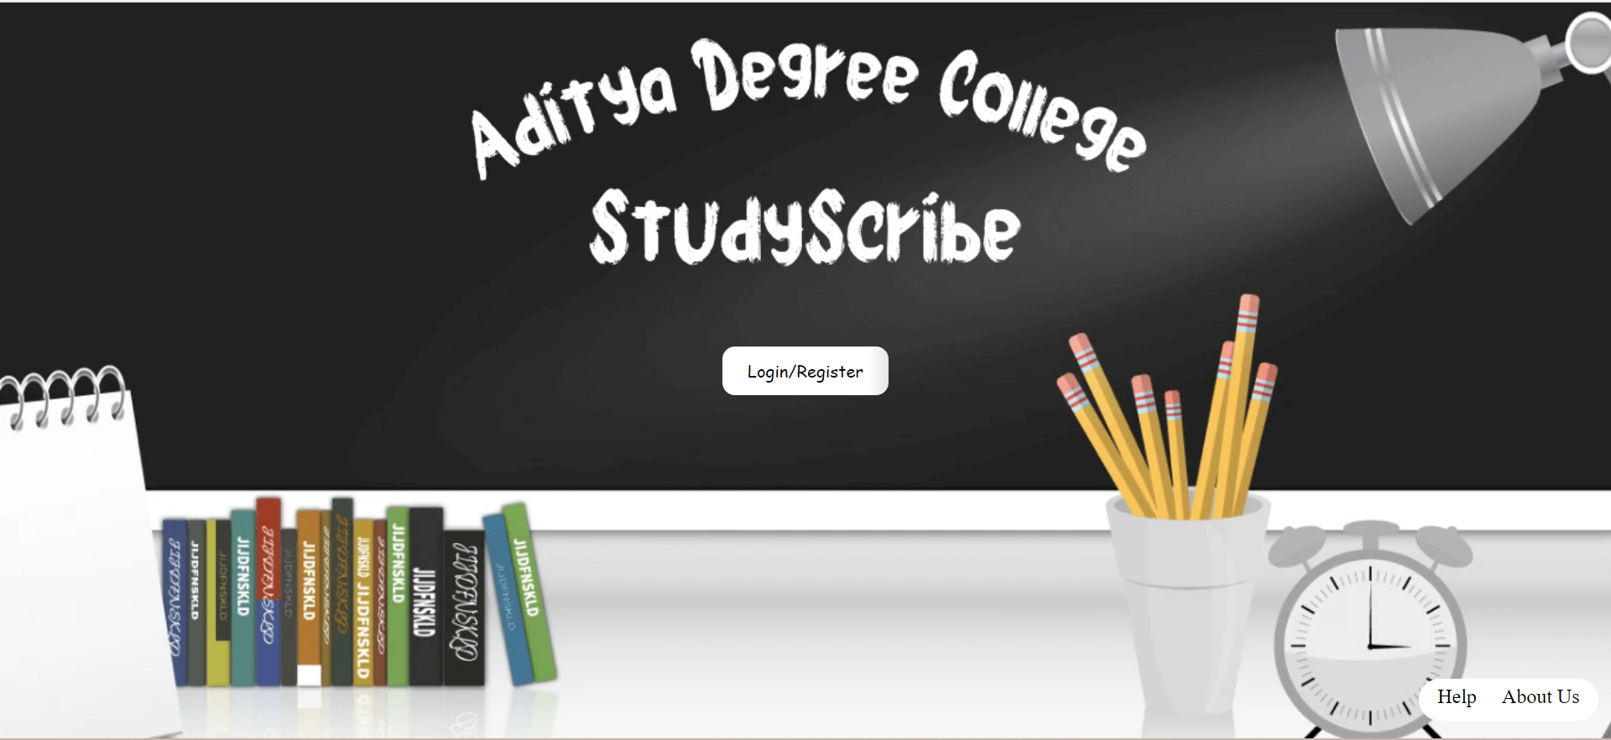
Click on “Login/Register” to move on to the login page.

Slide 2
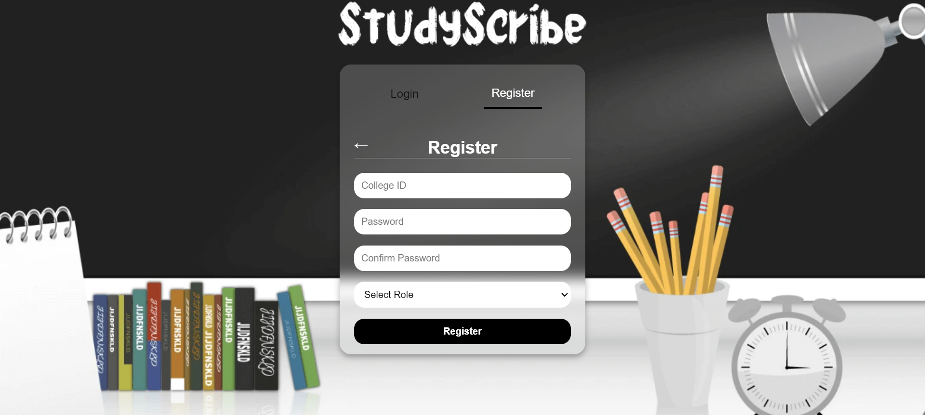
Every user must register first before trying to log-in.
Enter your SUC-ID and make sure that you set the last 4 digits of your ID as your password.
Student role will always be “Student” ,so please make sure you select the correct role.

Slide 3
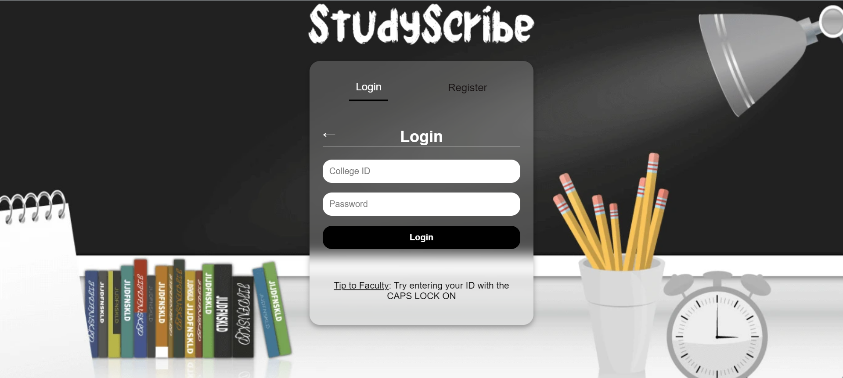
You will be automatically redirected to login tab and then you can enter the ID, your SUC-ID and the password which you had created in registration. Then click on login to experience STUDYSCRIBE.

Slide 4
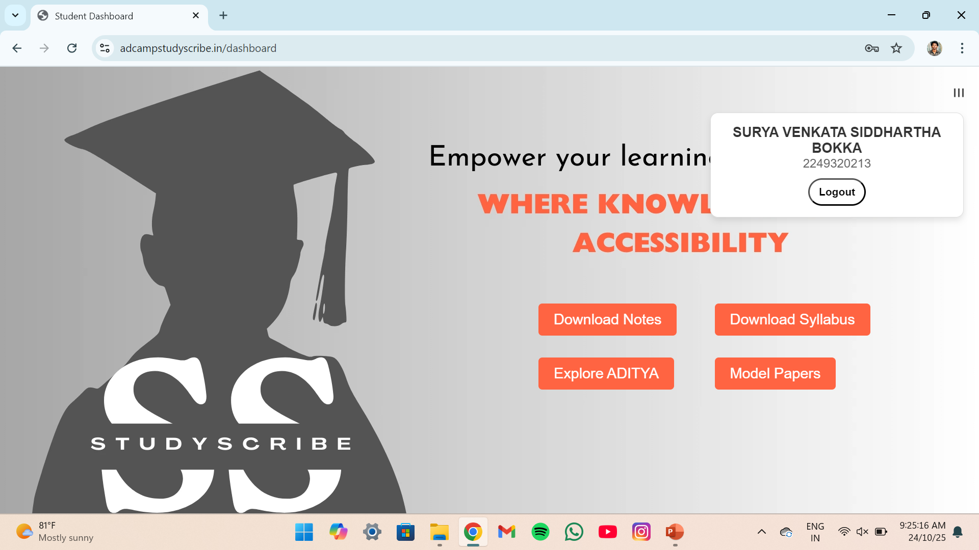
On the right corner of the screen, you can see your profile details with a logout option. Click on the button you need for example when you click on the download notes, next page will appear where you can download the available files.

Slide 5
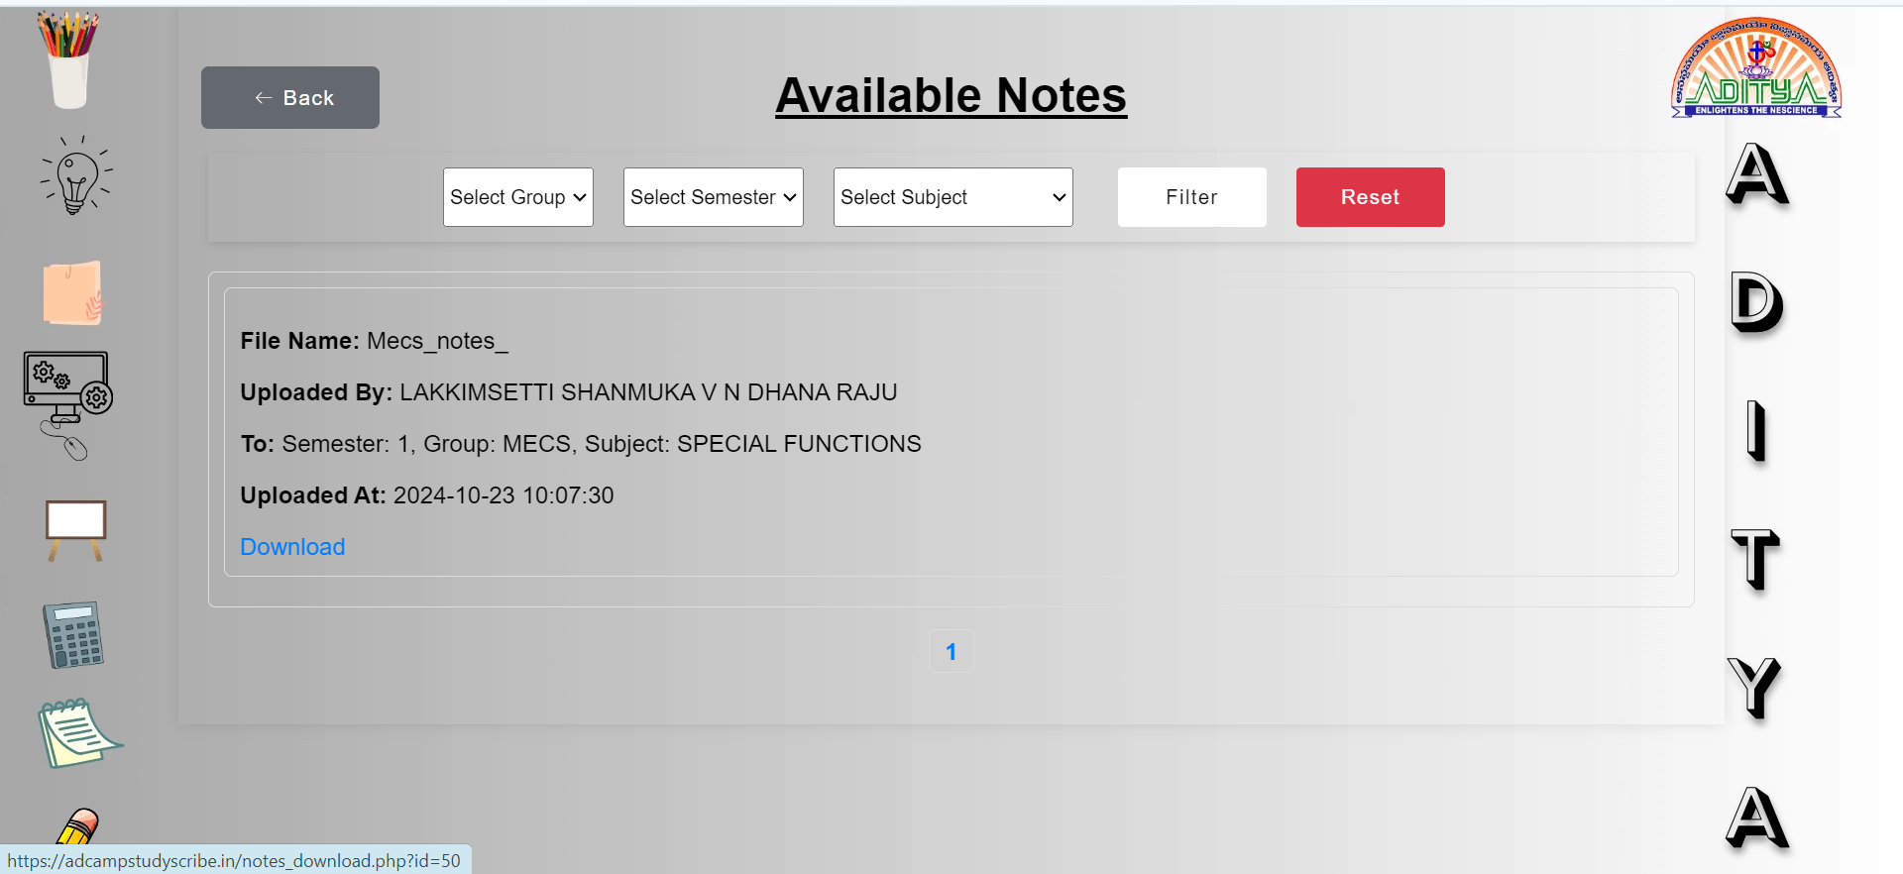
Here students can select their group, semester and subject then click on filter to get the related notes. Based on the group and subject chosen by the students the files will appear with details like file name, name of the lecturer who uploaded it, group details and time. Students can download the required files by clicking on download.

Slide 6
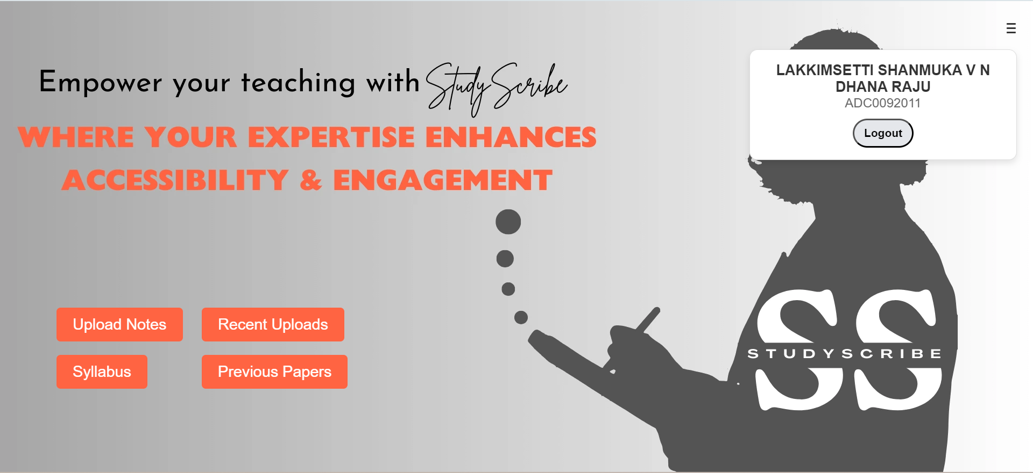
An icon will appear on the right corner of the screen and there the lecturer’s can see their profile details with a logout option. This page includes upload notes, recent uploads, syllabus and previous papers. When they click on the upload notes, next page will appear where the lecturer’s can upload the files.

Slide 7
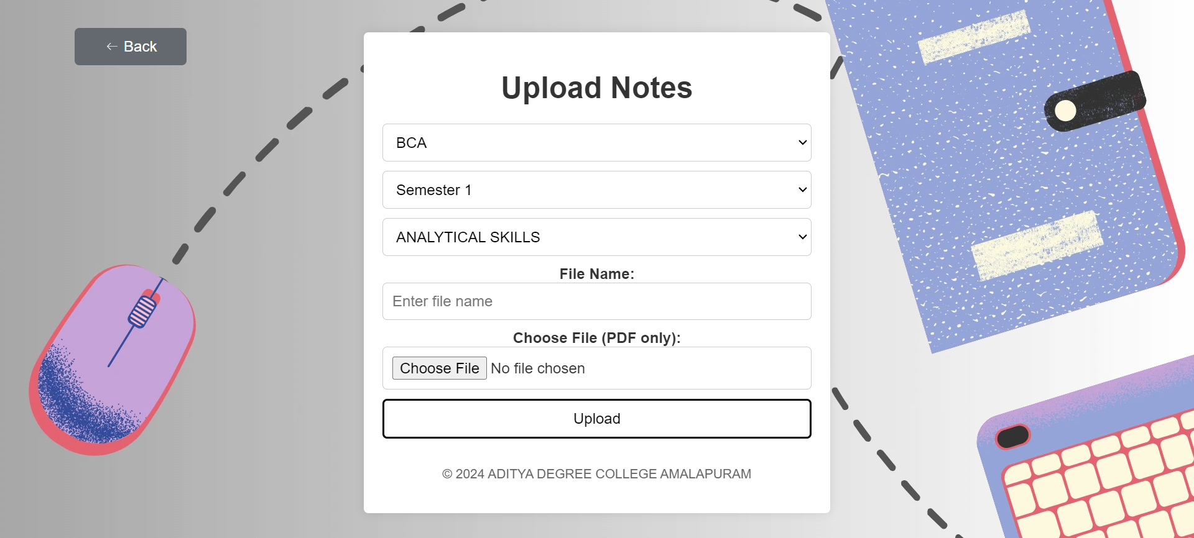
Here Lecturer’s have to select the group, semester, subject and enter the file name which represents the chapter or topic name. Then they have to click on choose file to select the file they want to upload. After the completion of choosing file, click on upload.
NOTE: The file must be in .pdf format.

Slide 8
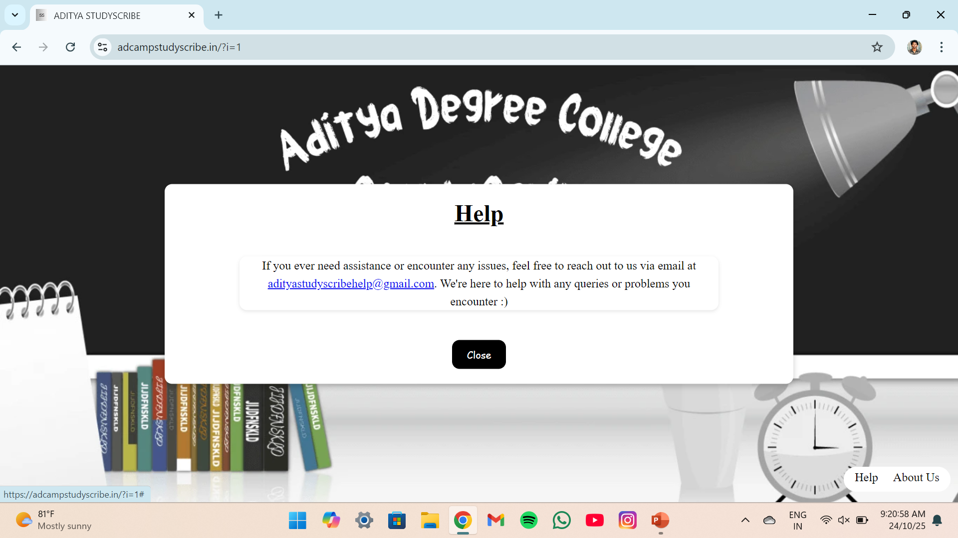

Slide 9
